Slide 1


What Lessons we learnt?

Slide 2
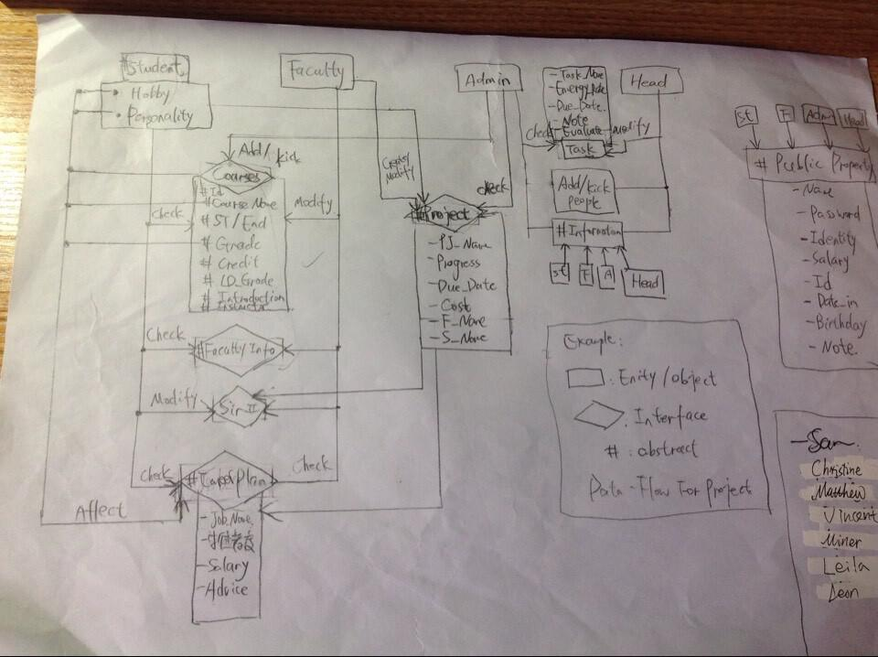

Slide 3

BUGs LEVLES IN OUR PROJECT:
Major Functions:
Log in ACCEPTED
Add / Kick People ACCEPTED
Check / Challenge / Modify Grades ACCPTED
Provide Career Instruction Minor: I / O Format Problem + Combination Problem
Modify Password and Email Major: 1.GregorianCalendar Error (Sometimes) 2. Other minor parts remain unimplemented.
Student Choose Course and check schedule: FATAL: Unable to implement.

Slide 4
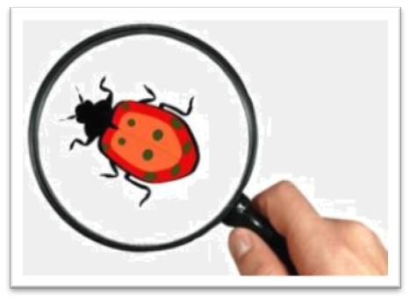
BUG LEVLES IN OUR PROJECT:
Minor Functions / Properties:
Change between frames ACCEPTED
Creating / Modifying Bulletin Minor: Users need to count the index of bulletin.
IO write / Read Minor: Some date maybe error through reading. (Sometimes)
Safety Issue : Major: Database not secreted
Sir-II Function: FATAL: Unable to implement.
Arranging Tasks: FATAL: Unable to implement.

Slide 5

Database Design Matthew
Student Class Leon
Faculty Class Miner
Admin Class Vincent
Head Class Sam
Interface Design Sam
Function Implementation Sam

Slide 6

Design Error: Not offering specified algorithms / ways to implement FATAL Parts, just offered GUI.
The GUI group is too slow at the very beginning: GUI (Front) should be the very first when you implement a project.
Didn’t consider the ability of programmers: Giving too hard tasks such as I / O management, interface instantiation.
Communication failure: Someone just doing their own job without considering how other parts will combine with them. (e.g. IO / GUI Problem)
Harsh time table: Remembering the wrong time table, I thought the semester ends at Dec.19th, so in my original design this project is done Dec.18th.

Slide 7


Have a detailed design of the project: How each parts connect with each other, what algorithm(s) should you use to implement each parts?
Design the GUI (front) part related to interaction first, not core things behind it.
Consider the ability of developers, try to make your codes as concise, as easy to implement as possible.
Forming good habits (We benefit from it this time)

Slide 8

NCRE-2 Standard:
Variables, methods should begin with lower case and at the beginning of each words later, it is upper case.
Class names, interface names, enum names should begin with upper case, and each of the words later also begins with upper case.
Constants should ALL_BE_UPPERCASE, use underline to separate each words.
All words should have reasonable meaning. (When you see it, you know what’s it)
Use notes and comments, to make other programmers understand a certain function in 30 secs.
A method is better less than 32 lines.

Slide 9

Rationality Study
Marketing
Request Study
ABSTRACT
Maintain
Software Design
DETAILED
Implementation
Retire
Test

Slide 10
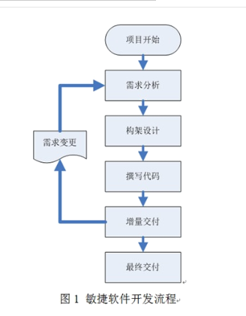
We didn’t follow the life-cycle strictly because detailed design is omitted.
During our project, We spent a lot of time doing testing, especially when it is something related to IO and GUI.

Slide 11


List: ArrayList and LinkedList
Set: HashSet
Array: Array of String
Scanner
Formatter
PrintWriter

Slide 12

